Slide 1



Peninsula Clean Energy
Board of Directors Meeting
March 31, 2016

Slide 2
Staff Report
Jim Eggemeyer, Director, Office of Sustainability
March 31, 2016

Slide 3
Timeline
Peninsula Clean Energy will begin serving customers in October 2016.
Phase 1
Phase 2
Phase 3
Phase 4
Jan – Sept 2015 | Oct 2015—Feb 2016 | March-Oct 2016 | Oct 2016 - Ongoing
Pre-Planning & Due Diligence | Community Outreach; Forming JPA; Planning and Development | Preparing for Launch | Serving customers
Internal planning team Initial outreach to cities and stakeholders Workshops and education Form Advisory Committee Technical study | Program and JPA design City outreach/passage of local ordinances Plan for JPA staffing/working capital Community outreach | First JPA Board meeting Submit implementation plan Energy supply and other service contracts Utility services Agmt. Initial staffing Regulatory registrations Marketing campaign Call center and customer notifications | Phased customer enrollment process Continual customer enrollment notices Focused business outreach

Slide 4
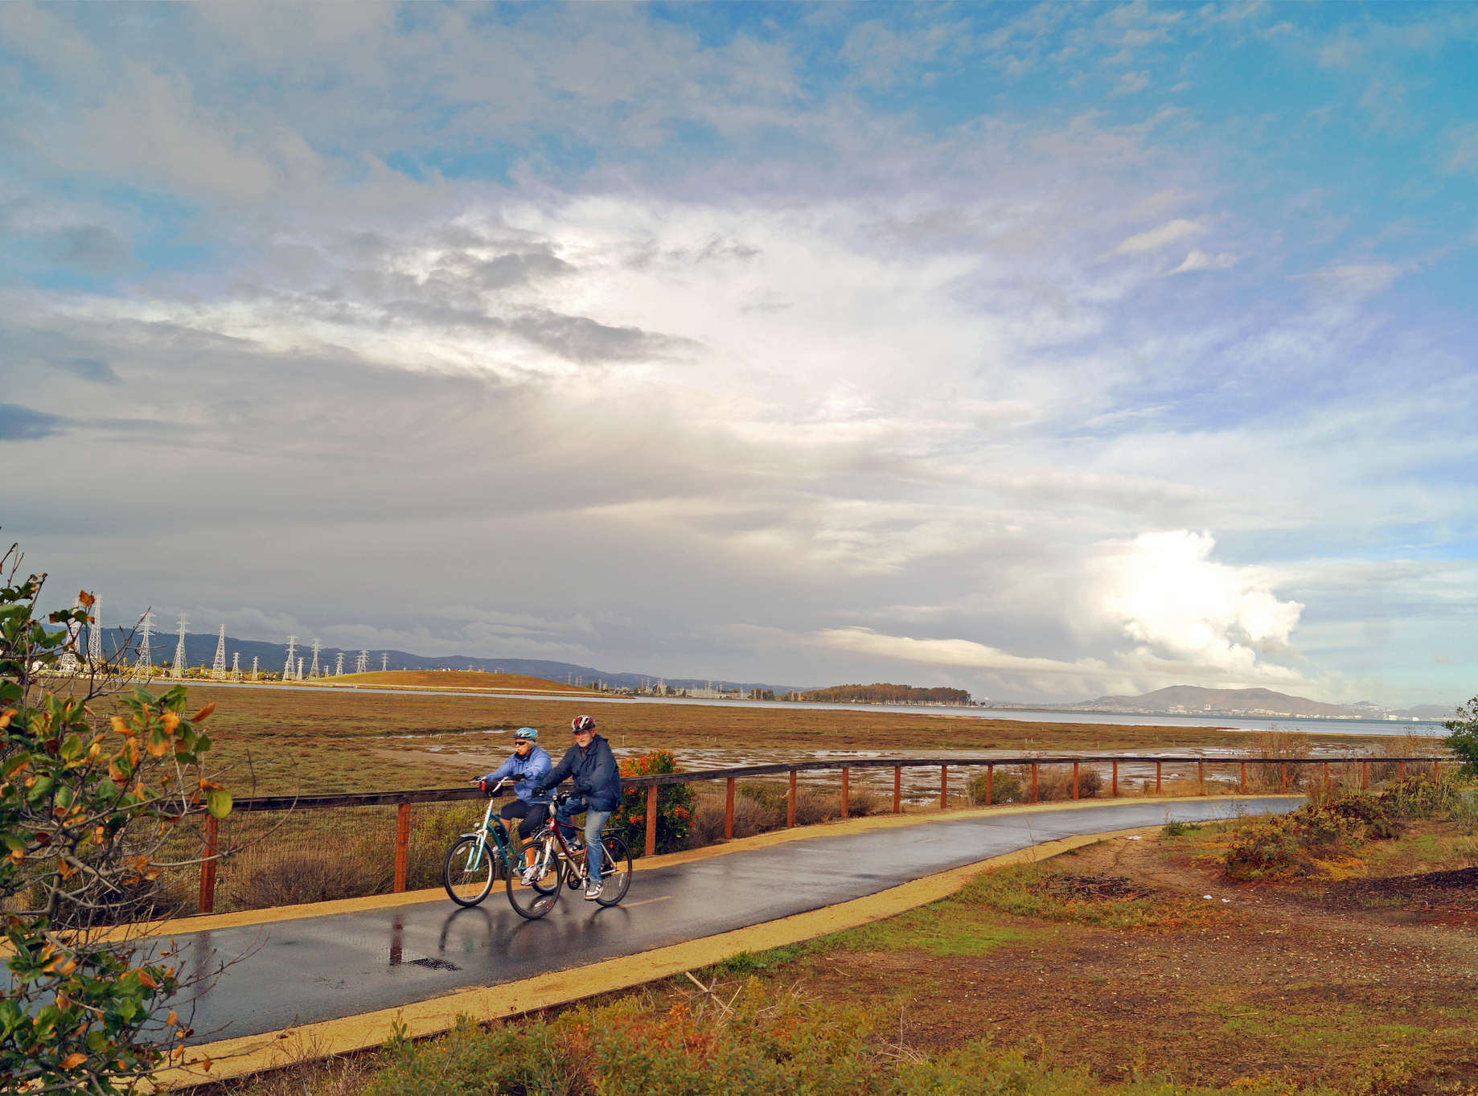
Questions and Discussion

