Slide 1
Level 2 EV Charging Power Management Overview

Slide 2
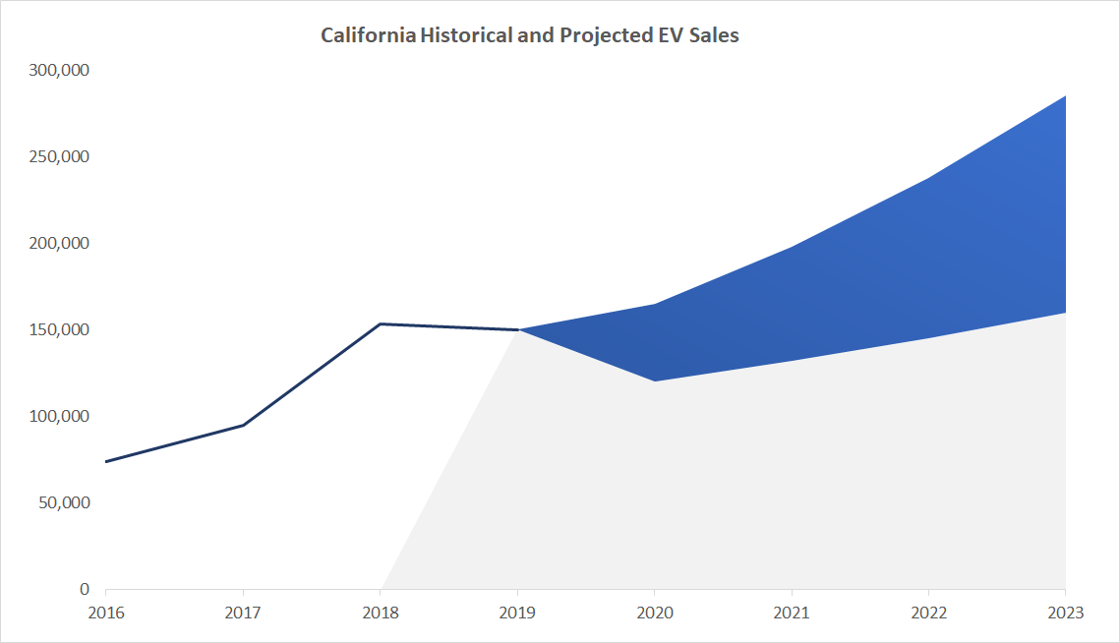
EV Adoption and Charging Demand
California goal to get 5 million EVs on the road by 2025 reducing transportation emissions 40% by 2030
45K – 65K EVs in San Mateo County by 2025 (~10% of all vehicles)
CA 100% ZEV sales by 2035
Notes:
The EV Ready Program is designed to meet California’s rising demand for EV’s. The state has a goal to put 5 million Evs on the road by 2025. We expect to have up to 65 thousand Evs in San Mateo County by that time. The California Air Resources Board is projecting EV sales in California to top 285 thousand vehicles annually in the next three years. The graph on the right shows that projection of annual EV sales steadily climbing.
But the biggest recent news has been that Governor Newsom signed an executive order that requires California to essentially ban new gas powered light passenger vehicle sales by 2035. That will affect this projection as California sells around 2 million new vehicles per year. This will also result in a need for EV charging infrastructure as we move further away from gas powered vehicles.

Slide 3
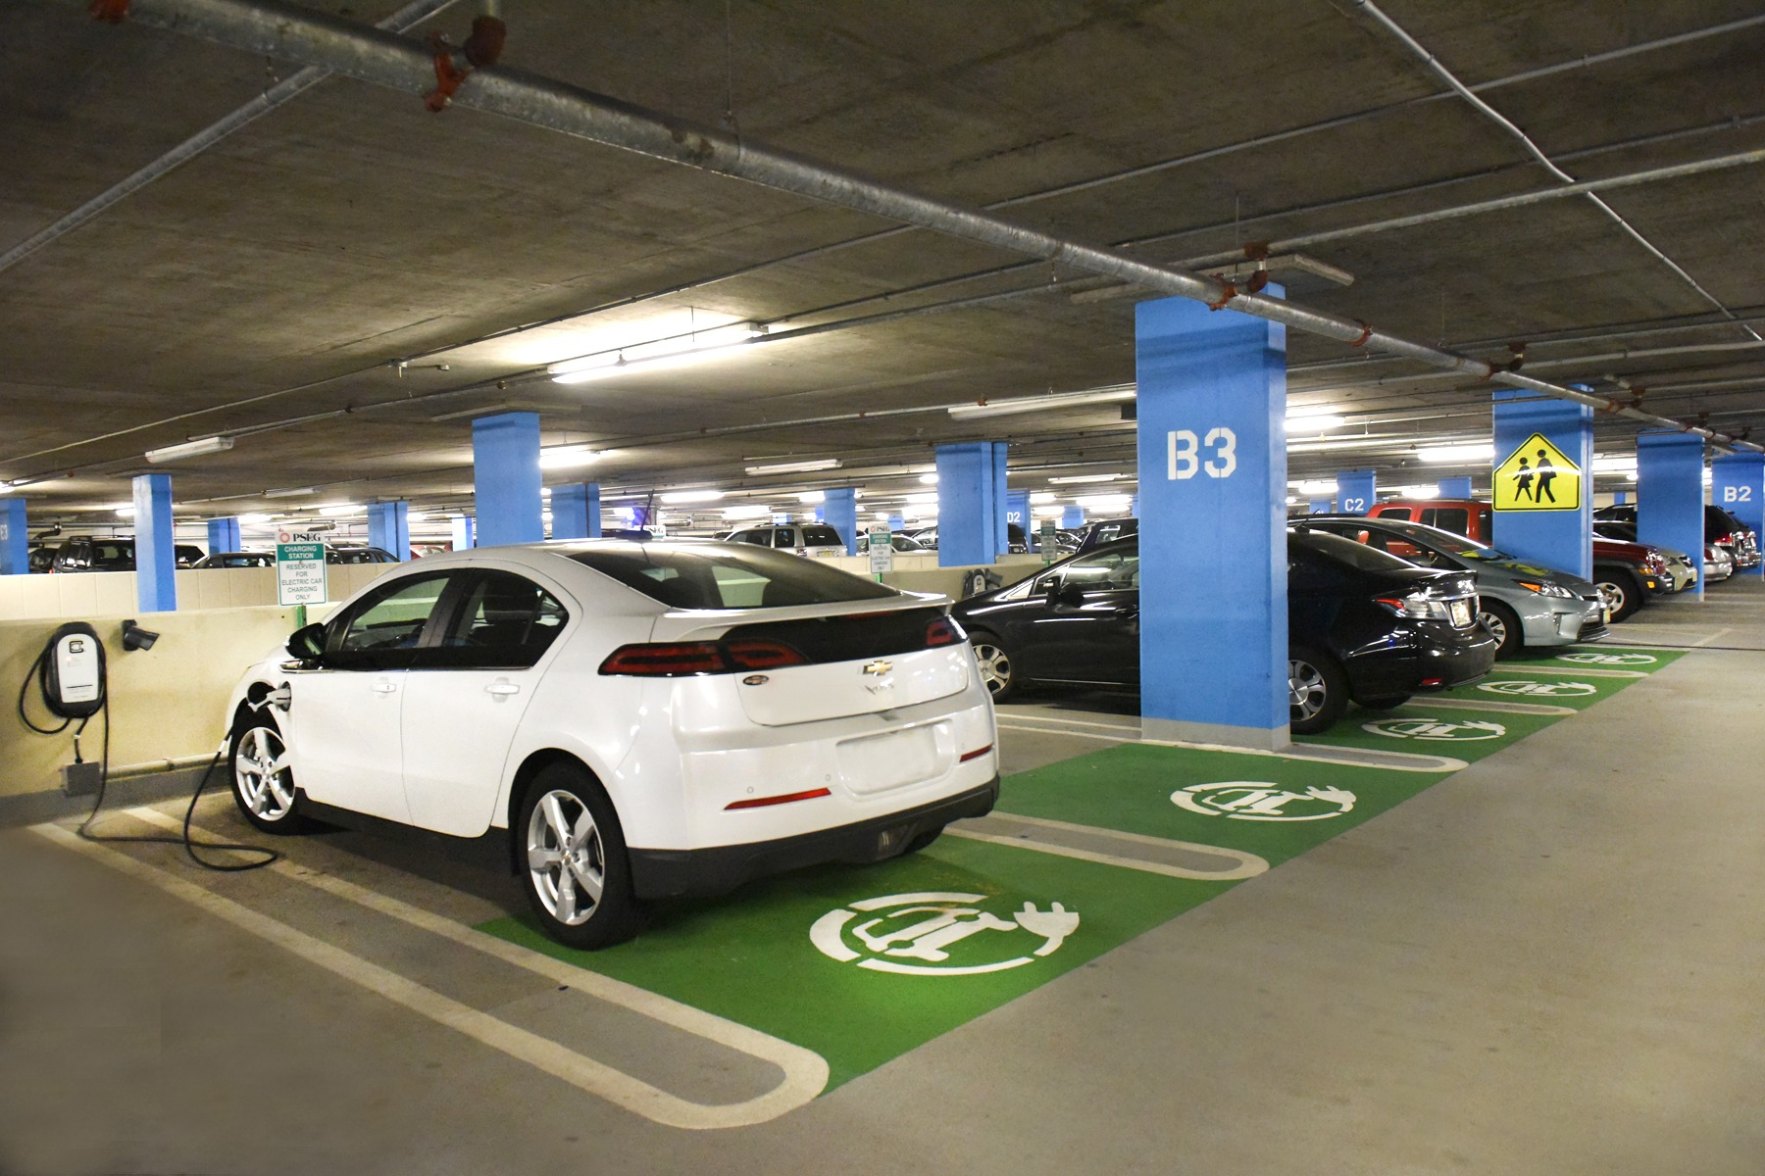
Average Charging Needs
Average San Mateo commuter drives 25 – 35 miles per day
~10 kWh
Traditional L2: ~1.5 hour charge
Power managed L2: 1.5 – 5.5 hour charge
Avoids oversized infrastructure costs

Slide 4
What are Advanced Load Mgmt Systems?
Designed to balance power so that total energy draw doesn’t exceed a circuit or panel capacity
Only triggered when enough EV charging occurs
Can avoid significant electrical capacity upgrades
NEC 625.14 and UL approved for safety
Two configurations: panel sharing and circuit sharing
NEC 625.14
“Where an automatic load management system is used, the maximum electric vehicle supply equipment load on a service and feeder shall be the maximum load permitted by the automatic load management system.”

Slide 5
UCSD Case Study
39 power managed L2 ports and DC Fast Charging
Power management (panel sharing) through PowerFlex
Overloading panel ~6X

Slide 6
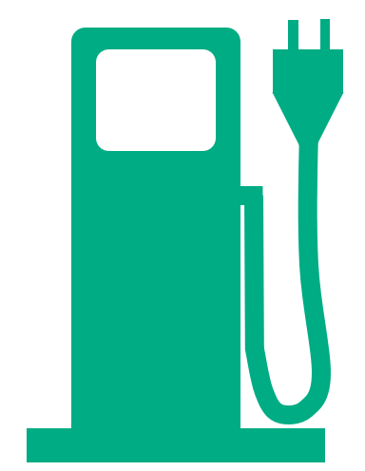
Circuit Sharing
40A
Definition: Multiple charging stations share the same electrical circuit
When one EV is actively charging, all circuit power is delivered to that station
7.2kW
40A
Circuit
40A (32A draw) 7.6 kw
3.6kW
3.6kW
Power is divided evenly as additional EVs are actively charging on the same circuit
40A
Unmanaged EVSE load = 160A, 28.8K (4x oversubscription)
1.8kW
1.8kW
1.8kW
1.8kW

Slide 7
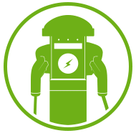
Panel Sharing
Balances power as additional cars plug in and cars stop charging.
Image to the right shows panel sharing at 100% capacity. 16+ kWh provided over 9-hour workday at 100% capacity. More power is provided as cars unplug or fill.
Unmanaged EVSE load = 480A, 68.4 kw, 4x oversubscription
Subpanel only has EV loads
Subpanel
8 A 1.8 kw
8 A 1.8 kw
8 A 1.8 kw
8 A 1.8 kw
8 A 1.8 kw
8 A 1.8 kw
8 A 1.8 kw
8 A 1.8 kw
120 A 21.6kw
8 A 1.8 kw
8 A 1.8 kw
8 A 1.8 kw
8 A 1.8 kw

Slide 8
Permitting

