Slide 1
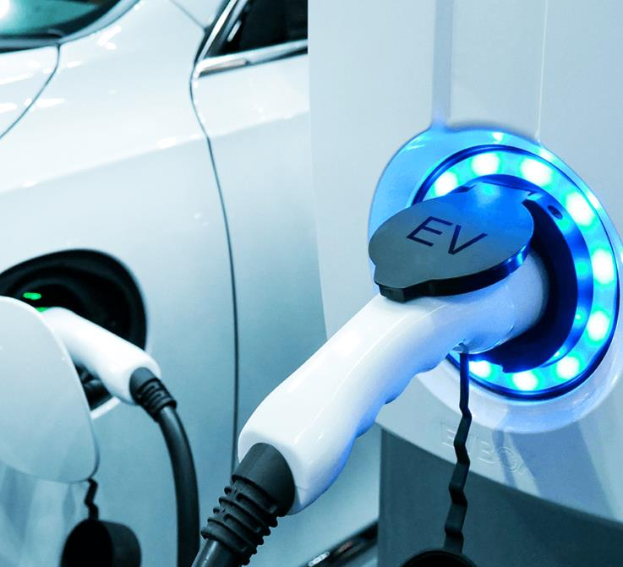
Cost Containment Strategies to Scale Charging Access
Overview of Peninsula Clean Energy’s Utilization of Level 1 and Power-Managed Level 2 Charging

Slide 2
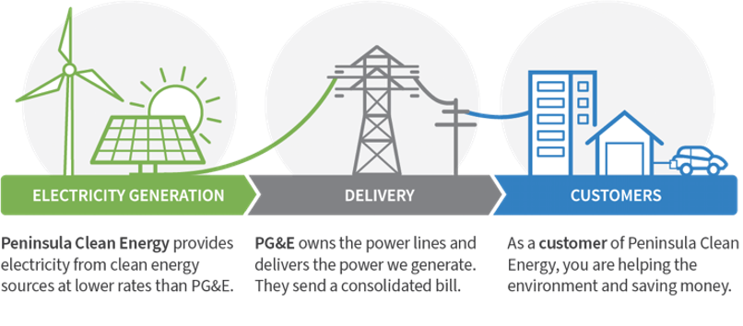
Peninsula Clean Energy
Peninsula Clean Energy is San Mateo County’s official electricity provider–generating clean and affordable power and making significant reinvestments back into the community.
How it works

Slide 3
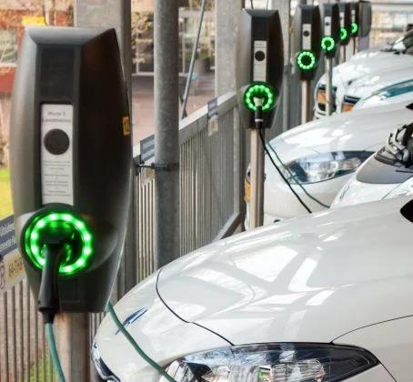
Challenges with EV Charging
California projected need:
3.8M - 6M charge ports by 2030
Expected to fall short of EVSE goals
Multifamily access is especially critical
Major equity implications
Principal gating issue is cost
Level 2 (L2) per port costs:
~$5,000 (MCE) to ~$18,500+ (PG&E)
Notes:
Charge port goal is to support 5M EVs by 2030: https://peninsulacleanenergy.app.box.com/file/689793676011
MCE L2 costs: Internal email from Brett Wiley
L2 costs for PG&E: https://www.pge.com/pge_global/common/pdfs/solar-and-vehicles/your-options/clean-vehicles/charging-stations/program-participants/PGE-EVCN-Quarterly-Report-Q3-2019.pdf

Slide 4
Charging Levels
Corridor/travel, supplemental
Supplemental
Daily
Daily
Fast Charging
Workplace
Residential
Destination
100 kW+
7 – 100 kW+
1.9 - 7 kW
1.9 - 7 kW

Slide 5
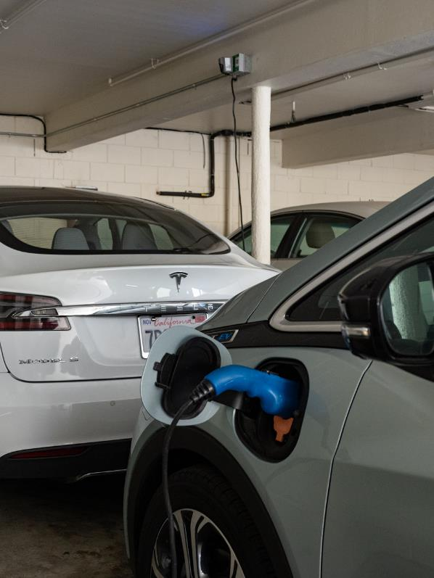
Model for Ubiquitous Access
Driver need? ~ 25 - 35 mi/day
1 hour on 7.2 kW L2 – far overbuilt for resi
Level 1 = 1.9 kW (dedicated 20-amp circuit) provides 40-50+ miles overnight
Level 1 (120v) and power managed L2 (208-240v)
50% of drivers today successfully use Level 1
Costs
Level 1: as low as $1,900/port
Power managed L2: as low as $3,600/port
4x to 6x the number of ports for same capacity
New construction: 3 – 4x less than retrofitting later
Notes:
Low end cost of L1 and power managed L2: https://peninsulacleanenergy.app.box.com/file/749569563400
50% of drivers use L1 per 2017 CARB study: California Air Resources Board, “California’s advanced clean cars midterm review: Summary report for the technical analysis of the light duty vehicles standards Appendix B” (2017), https://www.arb.ca.gov/msprog/acc/acc-mtr.htm
Also: https://peninsulacleanenergy.app.box.com/file/682883501162, also verified with internal PCE customers during Phase 1 Flexcharging pilot
Retrofit cost figure is $1,049 new construction vs $3,983 retrofit for MUD with 10% L2 and 90% L1 per Energy Solutions.
Citation for new vs retrofit cost figure - https://www.peninsulacleanenergy.com/wp-content/uploads/2020/08/PCE_SCVE-EV-Infrastructure-Cost-Analysis-Report-2019.11.05.pdf

Slide 6
What are Advanced Load Mgmt Systems?
Designed to balance power so that total energy draw doesn’t exceed a circuit or panel capacity
Only triggered when enough EV charging occurs
Can avoid significant electrical capacity upgrades
NEC 625.14 and UL approved for safety
Two configurations: panel sharing and circuit sharing
NEC 625.14
“Where an automatic load management system is used, the maximum electric vehicle supply equipment load on a service and feeder shall be the maximum load permitted by the automatic load management system.”

Slide 7
Circuit Sharing Example
40A
Definition: Multiple charging stations share the same electrical circuit
When one EV is actively charging, all circuit power is delivered to that station
7.7kW
40A
Circuit
40A (32A draw), 240V, 7.68 kW available
3.8kW
3.8kW
Power is divided evenly as additional EVs are actively charging on the same circuit
40A
Unmanaged EVSE load = 160A, 28.8K (4x oversubscription)
1.9kW
1.9kW
1.9kW
1.9kW
Minimum of ~60+ miles of range provided with overnight charge at MUDs. Real-world charge will be higher due to power balancing.

Slide 8
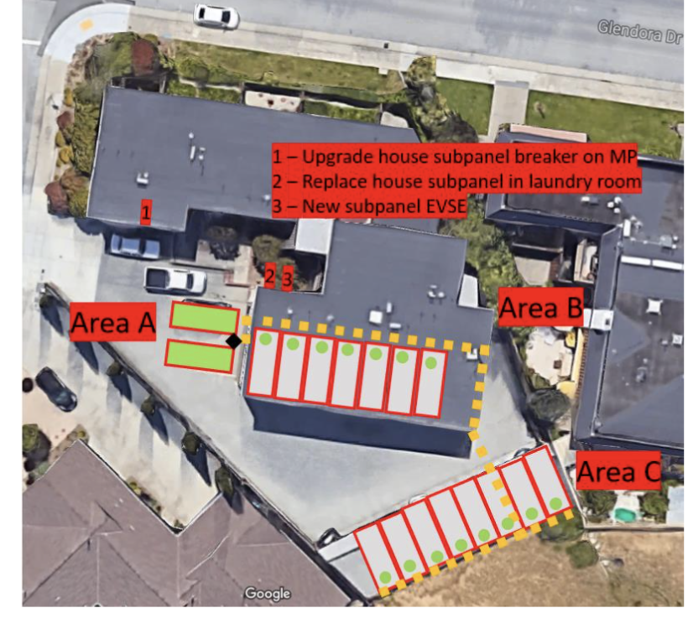
Multi-Family EVSE Retrofit Example
Background
17-unit apartment building in San Mateo County, built in 1975
Not enough power in main panel to support Level 2 charging for all residents at full power (40 amps each)
Project Details
Original request: 2 Level 2 dual-port stations (4 ports total)
Accepted project: 1 Level 2 dual-port station with power management and 15 Level 1 outlets (17 ports total)
Provides charging to all residents
Per port cost: $5,300 (total cost estimate: $90,600)
Installing 17 Level 2 ports would have cost at least $250,000+ (average $14,750+/port) and more if a new PG&E transformer was required
San Mateo Apartments

Slide 9
Issues with CALGreen Residential Approach
Overinvests electrical infrastructure
Most capacity is unutilized
Doesn't address critical cost barriers
High cost model
Restricts EV adoption
Very limited access (most parking is assigned)
Codifies inequities
Extremely high subsequent costs ($25-50k?)
Ignores fed/state/local momentum for power management
NEC code, CPUC VGI, local reach codes
20% get everything
80% get nothing
Notes:
1- another talking point is that it addresses cost by limiting EV ready deployment to only 10% of spaces. The real cost is the energy capacity and you can increase access without increasing costs there.
2- Adoption is limited to only those 10% of spaces. It's not often possible for tenants to move spaces around.
3- EV adopters will get the first stations, leaving out later adopters, more likely to be lower income (mention EV entitlement)
4- state proceeding and VGI working group all moving toward power management in future TE programs

Slide 10
Local Reach Code Adoption
Multi-family code
Every residential unit gets EV Ready space (circuit + outlet)
First 20 + 25% Level 2 Ready, 75% Level 1 Ready
Power management explicitly allowed
Details: www.peninsulareachcodes.org

