Slide 1
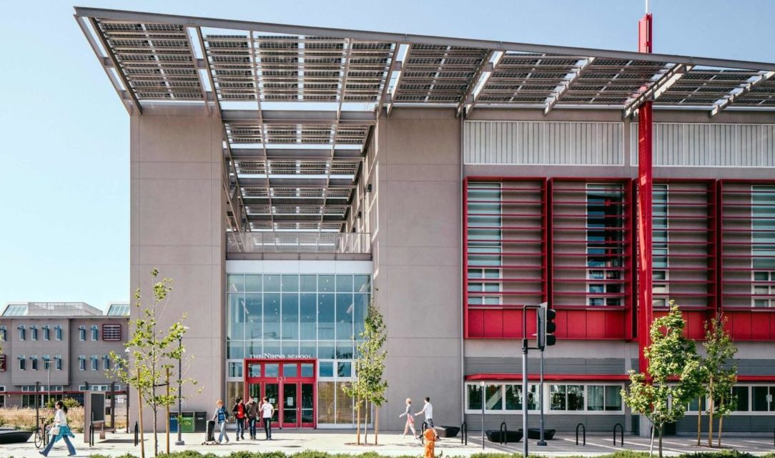
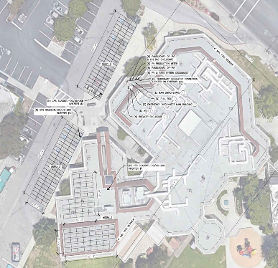
Public Facility Solar and Solar + Storage RFP
September 6, 2023

Slide 2
Agenda
About Peninsula Clean Energy
Overview of Public Facilities Solar Program
Overview of RFP
Questions
Webinar logistics
Please stay on mute if not talking
Please use “raise hand” feature to ask a question
Questions can be asked in comment box as well, but after those with raised hands
Slides and recorded webinar will be posted on website

Slide 3
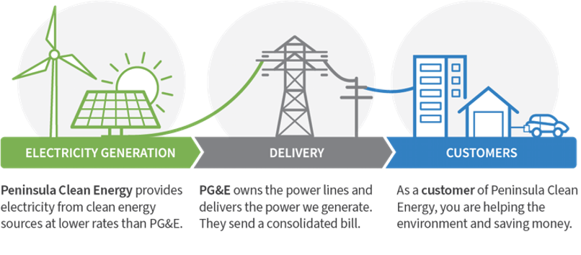
Peninsula Clean Energy
Peninsula Clean Energy is San Mateo County’s not for profit locally-led electricity provider
Mission: To reduce greenhouse gas emissions by expanding access to sustainable and affordable energy solutions
How it works
Notes:
Script:
Hi, my name is Peter Ambiel. I am a Programs Specialist at Peninsula Clean Energy overseeing our EV charging infrastructure programs. PCE is the CCA for San Mateo County

Slide 4
Peninsula Clean Energy Profile
Community Choice Aggregator
Public Agency - Joint Powers Authority
22 cities + County of San Mateo
Board: elected council members from each
Launched 2016
300,000 service accounts
1.1GW+ renewable PPAs under contract
Credit ratings
Fitch: BBB+
Moody’s: Baa2
S&P: A-

Slide 5
Program Goals
High Level:
Accelerate local renewable energy deployment at local public agency facilities
Develop a scalable program and new service model
Tactical:
Reduce the burden and associated costs for both public agencies and renewable energy vendors via PCE conducting site assessment and design activities
Reduce equipment costs via aggregation
Reduce vendor contracting costs via PCE serving as a single counterparty for vendors
Reduce financing costs by leveraging PCE’s financial strength and IRA’s Direct Pay

Slide 6
Building off a Pilot
Previously ran a smaller RFP of solar with optional storage
12 sites, 1.7MW solar, possible battery storage in future
Selected Intermountain Electric as EPC provider
12 PPAs signed: Public Agencies <-> PCE
EPC agreement signed: Intermountain Electric <-> PCE
Commenced construction; PTO expected Q1 – Q2 2024

Slide 7
RFP Key Details
Two portfolios, 42 sites, 16.5MW solar / >6.2MWh battery storage
Website link: https://www.peninsulacleanenergy.com/solicitation/solar-storage-aggregation-rfp/
Questions can be submitted to: ProgramSolicitations@PeninsulaCleanEnergy.com
Questions posted on the RFP website regularly
We will not publicly identify who asked a question but will post the question and response.
RFP Requires submission of a Statement of Interest and Qualifications to be qualified and receive full materials. Please submit as soon as possible.
Deadline for Statement of Interest and Qualifications: Sep 22, 2023
Deadline for submission of Proposals: Oct 16, 2023 Nov 13, 2023 (extended)

Slide 8
Statement of Interest and Qualifications
Basic company information
Confirm that you meet minimum requirements
Additional detail on past deployments
Company and team info
On a rolling basis, PCE staff will review submissions and send invitations to shared folders with additional project information for qualified Proposers

Slide 9
Overall Process
Site Level
Where we are now
Site Visit
Preliminary Site Plan / Sizing Report
Iteration with Facility Staff
Final Site Plan
Includes
Solar + storage sizing
Site plan + SLD
PVsyst estimate
Structural review
Portfolio Level
Secure LOIs from Customers
Run Competitive Solicitation For Equipment & Installation
Install and Maintain Systems
Aggregate Final Plans from Multiple Sites

Slide 10
Portfolio Details
 | Portfolio A | Portfolio B
# Sites | 33 | 9
Energy Rates | B1, B6, and B10 | B19 and B20
Solar kW (Carport / Rooftop / Ground Mount) | Total: 4,532 (872 / 2,883 / 777) | Total: 12,006 (926 / 10,396 / 684)
Storage kWh | TBD | >6,200
Development To-Date | Customer education, site walks, solar sizing, solar drawings, customers signed Participation Agreements, financial pro formas presented, IX applications submitted | Customer education, site walks, solar sizing, solar designs, customers signed Participation Agreements
Ownership Model | PCE will own all equipment | Exploring multiple models: PCE ownership OR third-party ownership

Slide 11
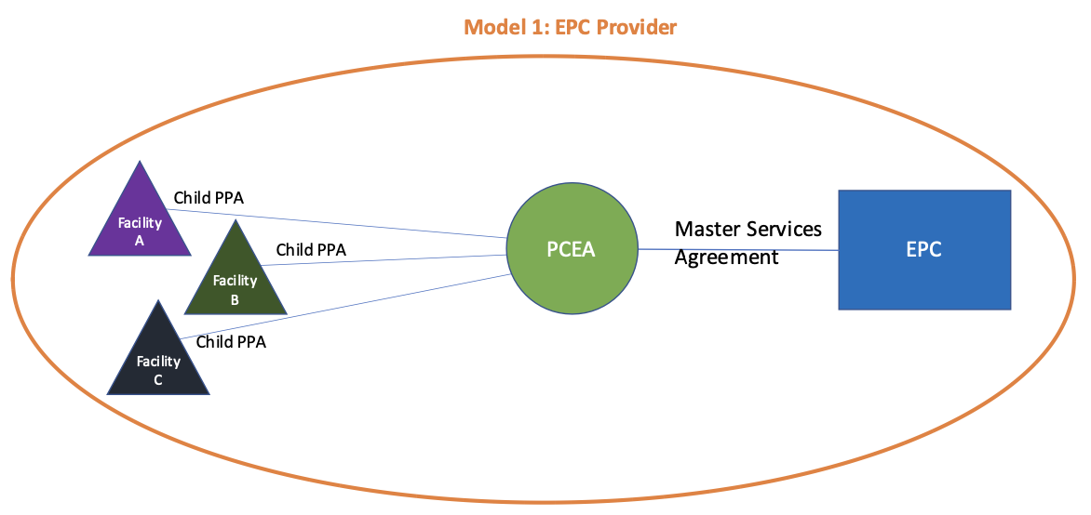
Procurement Model 1: Portfolios A and B
PCE contracts with EPC to procure and install equipment and provide ongoing maintenance/warranty service (either directly or via partner). PCE monetizes ITC via Direct Pay.

Slide 12
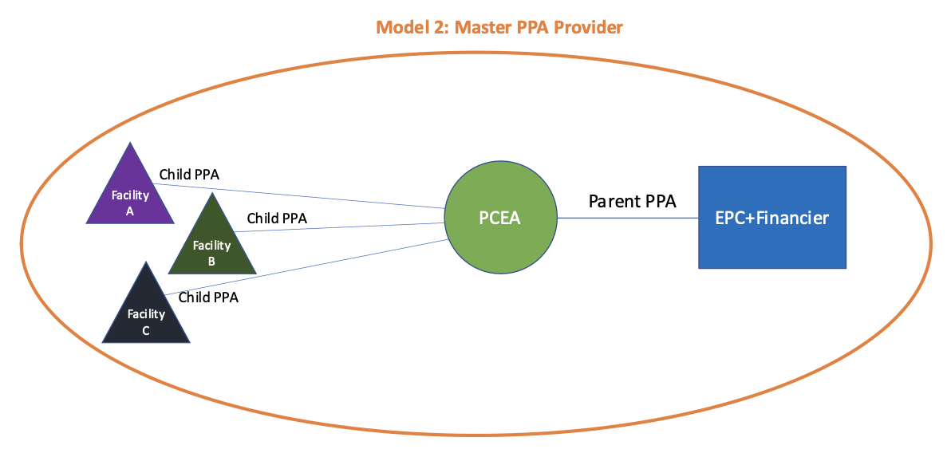
Procurement Model 2: Portfolio B
PCE enters into a Master PPA agreement with a Bundled PPA Provider (financier + EPC) for the aggregate portfolio.

Slide 13
Procurement Model Summary
PCE is seeking proposals from firms that fall into one or both of the following categories:
EPC contractors that will procure, install, commission, and maintain the systems for a specified price and do not monetize the tax benefits, which PCE does independently. (See Model 1)
Bundled Master PPA providers that will procure, install, commission, operate, and maintain the systems (via their own EPC contractor) and can provide Peninsula Clean Energy a 20-year Master PPA for all sites. (See Model 2)

Slide 14
Minimum Requirements
For all Proposers:
A minimum of 30 fully completed and operational solar installations, of which 5 are commercial installations with a capacity of at least 100kW each
A minimum of 5 rooftop, 5 carport, and 5 ground mount installations
A minimum of 10 installations in PG&E territory
For EPC contractors:
At least 5 years in business as a qualified contractor in California, with a C-10 contractor’s license
Demonstrable experience successfully applying for and receiving approved commercial interconnections with PG&E
No outstanding demerits or citations by the California CSLB for any reason for the past 5 years or more
For Master PPA Providers:
A minimum of 5 fully completed and operational battery energy storage installations of at least 100 kW
At least 5 years of operations in California
10+ years’ experience with commercial scale projects and PPAs, with strong individual executive and project team experience
Committed and readily available source of all required capital
Track record of successfully developing, constructing, financing, operating, and maintaining solar and solar + storage systems in California

Slide 15
Project Packages
Upon qualification, we will provide a link to a shared folder with Project Packages for each site. These contain:
Portfolio details: sites, agencies, system sizes, roof age, on-site generator, etc
Site plan with system layout and sizing
Single line diagram
1 year customer load data that was used to size solar + battery systems
NDA & Customer Data NDA required for access
Accessible on RFP website

Slide 16
Key Proposal Elements
Pricing: very important that in addition to providing required pricing, you explain how you would price any required changes to system design that may arise and any caveats/assumptions in your pricing
Equipment specs
Performance guarantee
Warranty info
O&M: important you are clear and detailed on your approach to O&M
Safety info: want to understand how you think about and advance safety

Slide 17
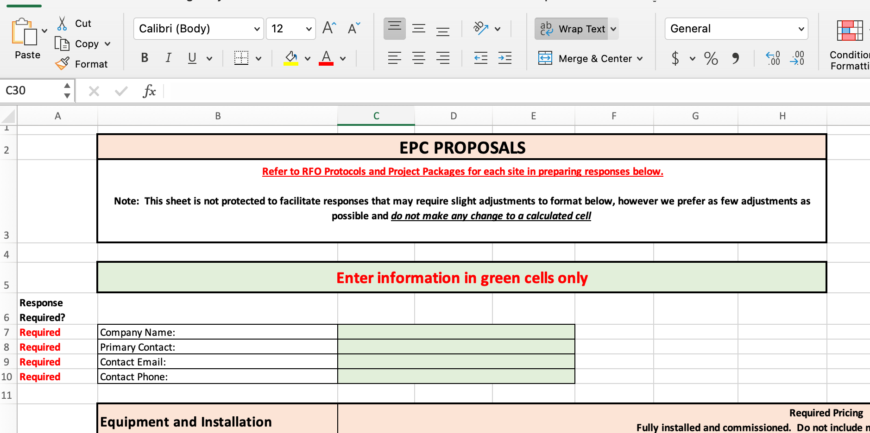
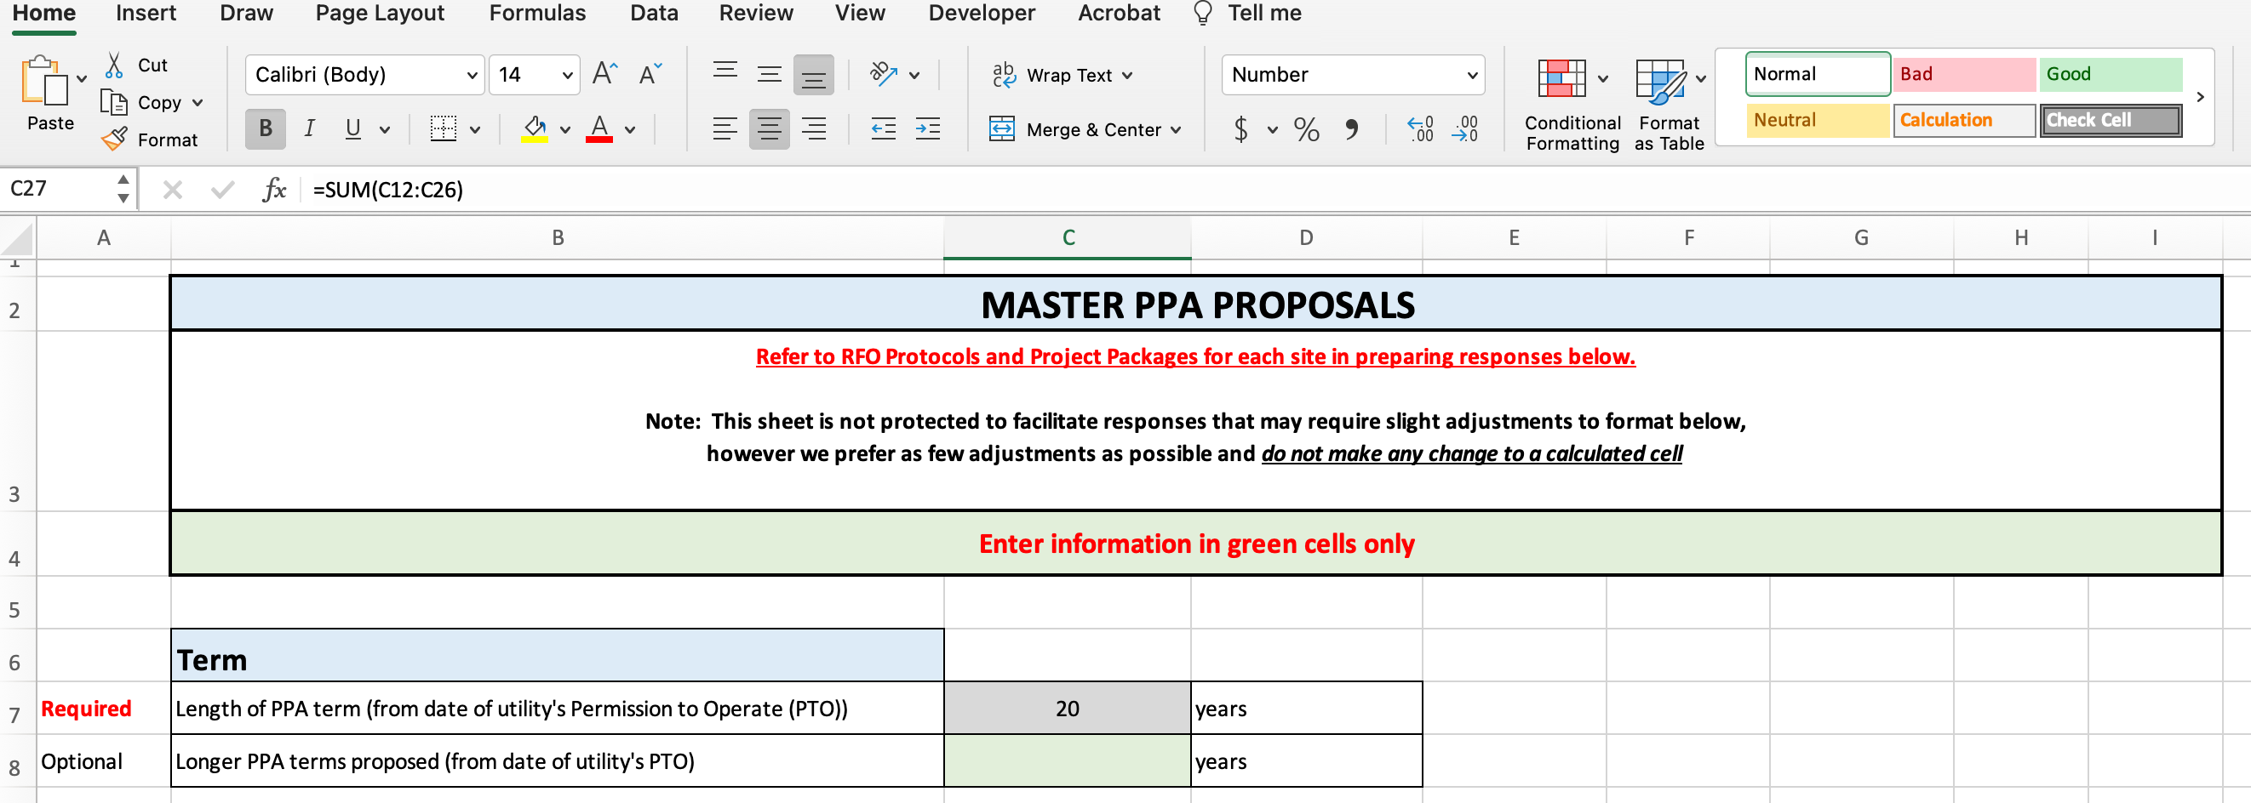
Proposal Form
Fill out the worksheet appropriate to how you are proposing
EPC Worksheet
Master PPA Worksheet
Fill out green cells only
Make sure to fill out all cells marked “required”
There is ample space/opportunity to provide additional detail or alternate proposals
Do not change any cell with a calculated formula

Slide 18
Submissions
All submissions via email to:
ProgramSolicitations@PeninsulaCleanEnergy.com
Subject: [Company] – [Submission Element(s)]
Deadline for Statement of Interest: Sep 22, 2023
Deadline for Submission: Oct 16, 2022 Nov 13, 2023 (extended)

Slide 19
After RFP Close, Next Steps
PCE selects shortlist
PCE determines preferred ownership structure for Portfolio B
PCE interviews shortlist and selects 1-2 partners
Contract negotiations with selected firm(s) & customers

Slide 20
The End
Thank you for your time and interest.
We look forward to your proposals.
Questions?
Please use “raise hand” feature
This deck and recording will be posted on RFP website

